Slide 1
Digital Security is for everyone
part one
Shannon Turner
Twitter: @svthmc
Notes:
This training was created for people who are not sure how to protect themselves online but want to know how to get started.

Slide 2
Learn how to recognize threats to your computer, your accounts, and your personal information
Learn the most impactful practices and tools you can use to keep your accounts and information safe
Notes:
It’s important to note that this should be considered an intro training. This does not cover every single thing you will need to do or can do. We will not talk about every threat. We will cover the most common threats and how you can protect yourself. This training is meant as a starting place, especially if you’ve never thought too much about how to protect yourself.

Slide 3
Outline
Two-factor authentication
Strong passwords and password managers
Security and privacy settings
Personal information and security questions
Recognizing and avoiding fraudulent emails and websites
Recognizing and avoiding malicious email attachments
Setting up automatic updates
Locking your computer and phone
Notes:
These are the main topics we’ll be covering during this training. A big part of this training is showing you how to recognize what emails and websites are legitimate and which are not. Learning these skills is just as important as using the right tools.

Slide 4
prevent 99% of attacks
Learn to recognize fraudulent emails and websites
Don’t open, don’t click, don’t download attachments, don’t enter your information
They’re trying to trick you. Be skeptical.
Keep your software up to date
Use strong passwords and a password manager
Use two-factor authentication where available
Notes:
With these five steps, we’re going to learn how to protect ourselves from 99% of the most common threats.

Slide 5
TWO-FACTOR AUTHENTICATION

Slide 6
TWO-FACTOR AUTHENTICATION
Two-factor authentication is when you need your password and something else in order to access your account.
Most commonly, that something else is a numeric code that gets texted to your cell phone, or a smartphone app that you use when you log in.
Notes:
Setting up two-factor authentication to send you an SMS code is good but Authenticator apps are more secure.

Slide 7
TWO-FACTOR AUTHENTICATION
Two factor authentication is one of the best ways to secure your accounts.
Even if someone got your password, they wouldn’t be able to get in unless they also had your cell phone.
Notes:
There are other ways to do two-factor authentication beyond SMS and smartphone apps like USB keys, but we won’t talk about those here.

Slide 8
TWO-FACTOR AUTHENTICATION
Google https://myaccount.google.com/secureaccount
Facebook (Login Approvals) https://www.facebook.com/settings?tab=security
Twitter https://twitter.com/settings/security
Notes:
Here are the links to set up two-factor authentication for Google, Facebook, and Twitter. Many programs and services offer two-factor authentication, not just these three, and you should use it whenever and wherever it’s available. You’ll also want to review the other security and privacy settings on these pages too.

Slide 9
Strong Passwords & Password Managers

Slide 10
passwords are important
Even if you have two-factor authentication enabled, make sure you are using strong passwords!
But what makes for a strong password?

Slide 11
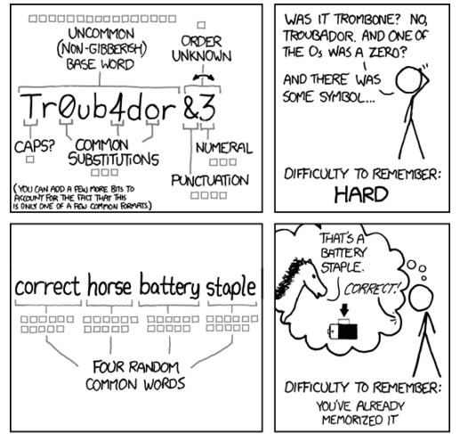
adapted from xkcd.com/936
Notes:
This comic pokes fun at passwords. A lot of accounts force you to add numbers, symbols, and capital letters to your passwords to make them “stronger” but that often just makes them harder to remember without making them more secure. The most secure passwords are very long and easy to remember.

Slide 12
Good passwords are
LONG
Difficult for someone else to guess
Easy for you to remember
Not reused across multiple accounts
Notes:
Why can’t you re-use passwords? Let’s say I use the same password for my email and for my online banking. If someone got the password to my email, they could also get into my bank account.
If you can’t reuse passwords, it can be challenging to create long, secure passwords unless you use a password manager. We will talk about password managers in a couple of slides.

Slide 13
COMMON (BAD) PASSWORDS
Don’t use these in your passwords!
Birthdays, especially of family, children, partners
“password” or “secret” or “qwerty”
The same thing repeated over and over
Names of your pets or children
Anything that could be guessed from your Facebook
Notes:
These are very commonly used in passwords — if you have these in your passwords, you’ll want to change them!

Slide 14
Password managers
LastPass stores your passwords securely so you don’t have to remember them.
It can generate strong, secure passwords for you.
https://www.lastpass.com
Careful: Just don’t forget your master password or you’ll lose all of your passwords.
Notes:
There are many password managers out there, but I like and use LastPass.
It’s free for personal use! One of the best features of LastPass is that it can generate long, secure passwords for you.

Slide 15
lock down your email
Your email accounts are your MOST CRITICAL accounts to protect
“Forgot Your Password?” password resets go to your email
So if your email is compromised, any accounts connected to that email could be compromised too
Notes:
Secure your email accounts first, and use two-factor authentication and strong passwords.
Google has a security check with many settings to give you peace of mind in addition to two-factor authentication, so be sure to walk through each step carefully.

Slide 16
lock down important accounts
Make a list of all of your important accounts:
Online banking, loans, anything financial
Anywhere you’ve saved a credit card (Amazon, etc)
Social media
What else?
On every account: Use two-factor authentication, strong passwords, and review security and privacy settings
Copy this Sample Worksheet
Notes:
(This doesn’t list every type of account because it’s important to have folks think about what their specific types of accounts are)
You’ll want to brainstorm every online account that you have and make a list. Keep a spreadsheet if it helps you, and track whether you’re using a strong password, whether you have two-factor authentication enabled, and whether you’ve reviewed the security and privacy settings.
One thing to keep in mind: many accounts offer two-factor authentication but not all will.

Slide 17
Privacy Settings and your personal info

Slide 18
SECURITY & PRIVACY SETTINGS
There are many security and privacy settings to configure depending on the account.
For example, Twitter can store location data with your tweets, which could allow someone to know exactly where you’ve been or know where to find you.
What personal information about you is visible on Facebook? Is that information visible just to your friends, or to friends of friends, or everyone?
Notes:
Every account will have its own security and privacy settings to learn and review, and you may need to review them periodically as new features are added. Facebook is notorious for adding new features and changing existing ones.

Slide 19
your personal information
What type of personally identifiable information about you is available on your profile?
Is your birthday on your profile? Your birth year?
Can someone reading your Facebook figure out your mother’s maiden name?
Notes:
Your birthday and your mother’s maiden name are often used as security questions to verify your identity when talking to your bank, for example. Think about the worst case scenarios here - and be very careful about the things you share online for everyone to read.

Slide 20
recognizing & avoiding fraudulent emails

Slide 21
tricking you is easier than hacking
Why hack into a system if they can trick you into handing over the keys?
Nobody legitimate will ever ask you for your password.
A common trick is someone “from IT” calling to tell you they need to fix a “problem with your account”

Slide 22
Watch out for scam emails
“Nigerian Prince” scam
Sudden inheritances from long-lost relatives
Relative traveling abroad, got hurt, needs help
Fake US government emails targeting immigrants
These scams almost always revolve around money
If it’s too good to be true, it probably is
Notes:
Just give me your bank account number and I will route the money to you!
You just need to pay inheritance tax on your newfound riches first!
The details are often spotty or missing, but the sense of urgency or missed opportunity can get you
Beware of emails that claim they are from the US government, promising an expedited green card, or saying there is a problem with your immigration status and you need to send money to fix it

Slide 23
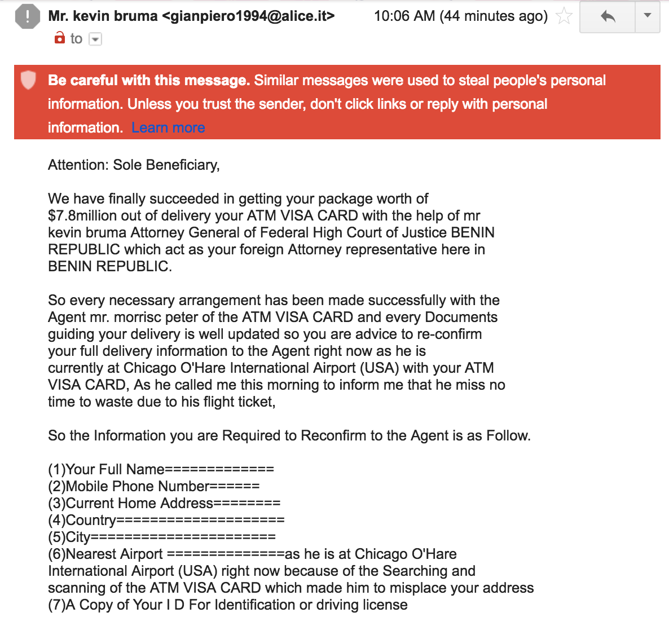
Watch out for scam emails

Slide 24
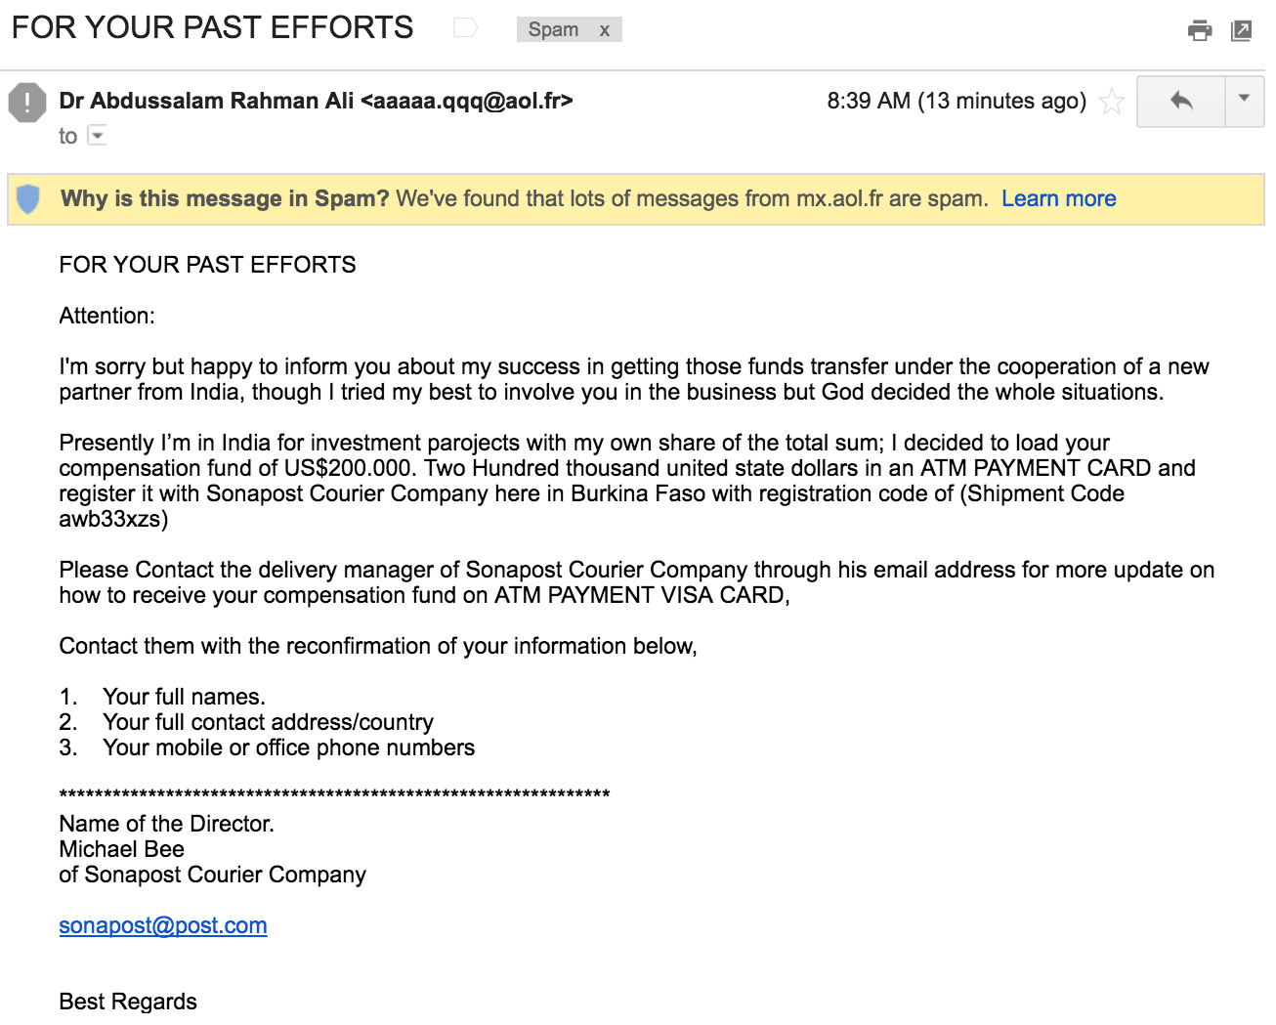
Watch out for scam emails

Slide 25
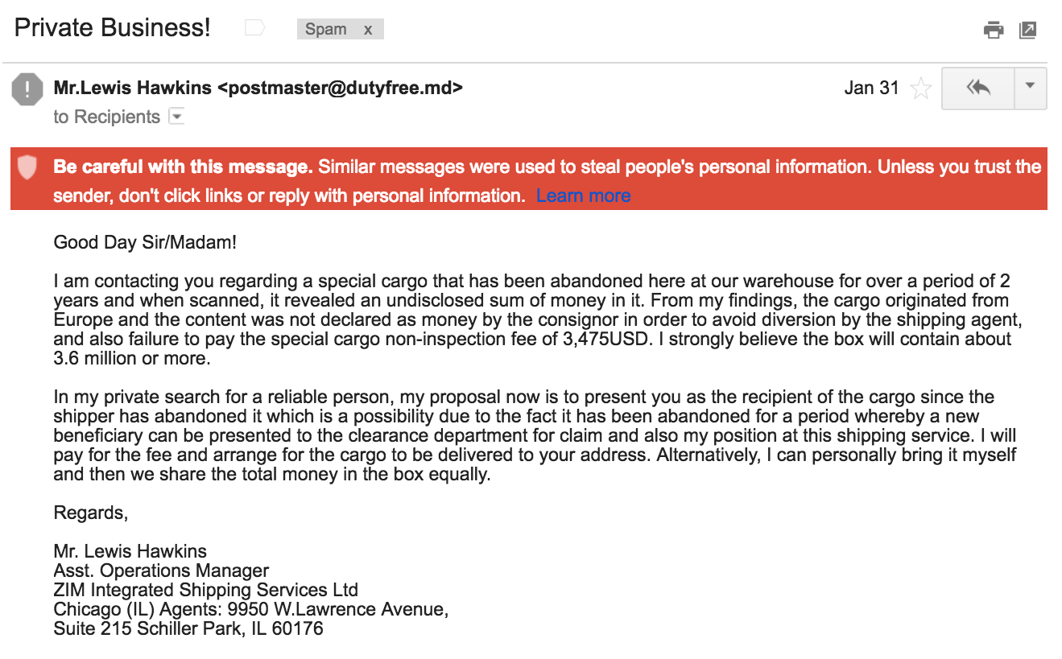
Watch out for scam emails

Slide 26
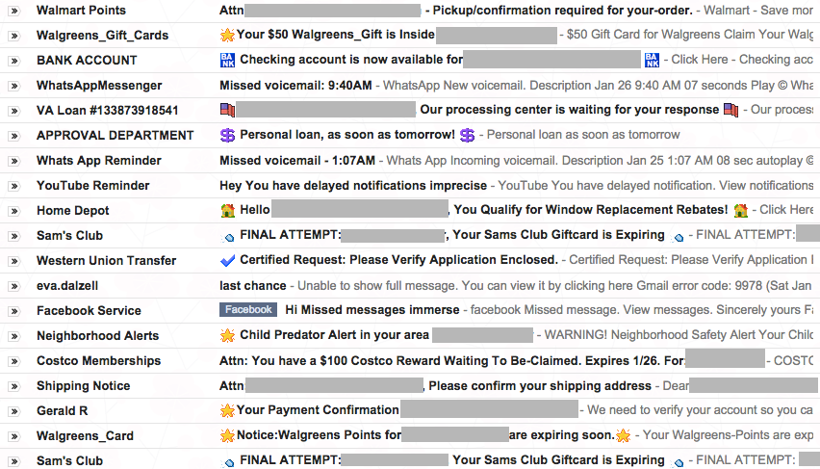
Be skeptical
Notes:
Here is a sampling of fraudulent / phishing emails I’ve received. Notice how they’re all trying to grab my attention and get me to open and click. I have a gift card to claim, a missed voicemail at 1:07 am, a response on a loan, a child predator alert. There’s a lot going on here.
These emails are trying to trick you - look at how many of them employ a sense of urgency, or missed opportunity, or make you curious, or appeal to fear or authority.

Slide 27
Be skeptical
These emails are trying to trick you
They want you to open, click, and usually enter in your account credentials
So instead of me getting a $100 Costco reward, instead they would get access to my Costco account!
Notes:
So let’s say I opened up the email from the previous screen that promised a $100 Costco reward that I needed to claim. If I opened the email, clicked through, and logged into my account, I would be giving away my password to the hackers and they could get into my account.

Slide 28
Be skeptical
These emails are trying to trick you
Not all fraudulent emails will be so obvious!
If you can tell it’s a fraudulent email without opening, delete it without opening!

Slide 29
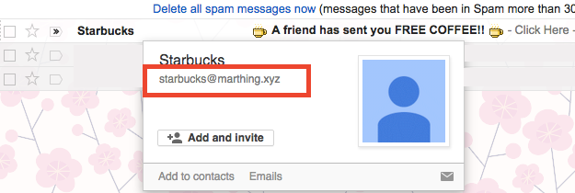
verify the sender
Verify the sender by hovering over the sender’s name.
If this were legit, it should come from starbucks.com, not marthing.xyz
Notes:
Keep in mind that fraudulent emails will often use slight misspellings or spellings that are just a letter off that may look “close enough” if you’re not reading closely, going too quickly, or have impaired vision.

Slide 30
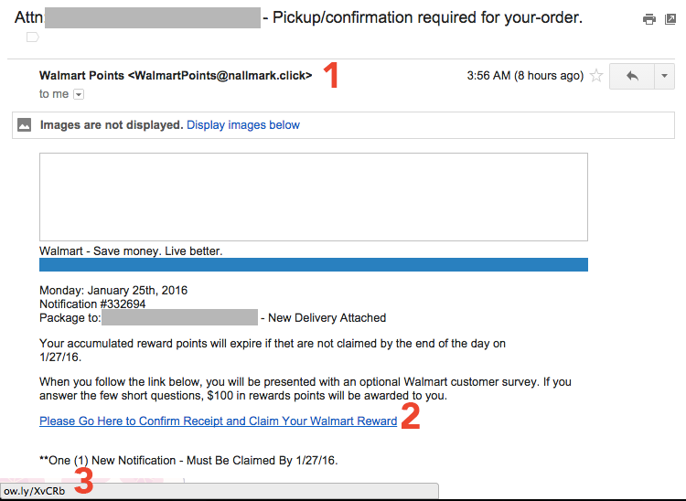
verify the link
Notes:
If we accidentally opened a fraudulent email, we can still figure out that it’s a fake.
In #1 we see that the return address is nallmark.click, not walmart.com as we might expect if this were legit. Remember that they’ll often rely on close misspellings.
If we hover over the link shown in #2, the status bar at the bottom of our screen (#3) will show that link that it would take us to, BEFORE we would actually go there. Get in the habit of hovering over links to see where they go before clicking.
In #3 we see that this email has used a link shortener to obfuscate where the link would actually go. If this link were legit, I would expect it to go to walmart.com*
One caveat is sometimes legitimate email marketers will use long, confusing links that are difficult to figure out exactly where they go. In that case, make sure you trust that email before you click.
Let’s say I wasn’t sure if I actually did have a Walmart reward waiting to be redeemed. Instead of clicking the link in this email, a better solution would be going to the Walmart website directly and checking my account there.

Slide 31
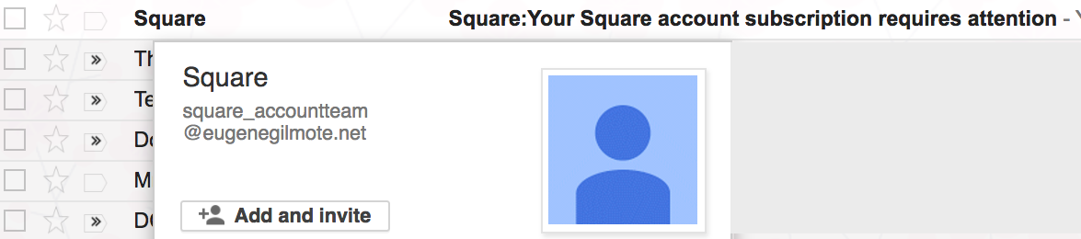
verify the sender
Verify the sender by hovering over the sender’s name.
If this were legit, it should come from squareup.com, not eugenegilmote.net
Notes:
Keep in mind that fraudulent emails will often use slight misspellings or spellings that are just a letter off that may look “close enough” if you’re not reading closely, going too quickly, or have impaired vision.

Slide 32
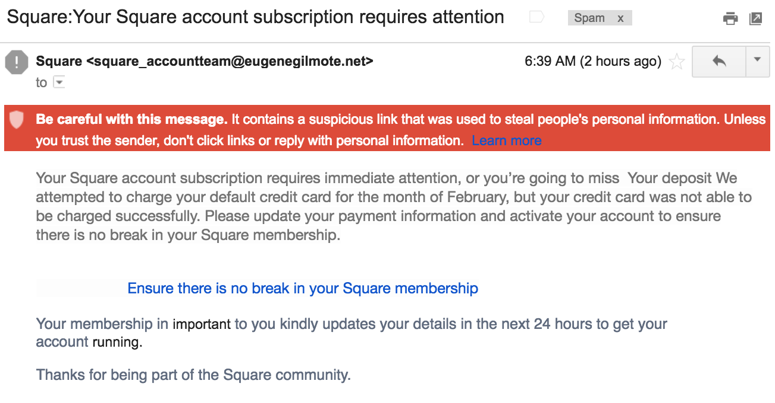
verify the link
Notes:
One nice feature of Gmail is emails that are reported as being phishing messages will get a warning banner at the top of the email, and they’ll remove the images and the links so you can’t click on them.

Slide 33
Let’s review
Be skeptical! They’re trying to trick you!
Verify the sender’s email
Hover over links to find out where they go before you click
If you think an email is fraudulent, DELETE!
Notes:
Keep in mind that if you’re checking your email on your phone, it’s very difficult to verify the sender, and you can’t really hover over the link to see where it’s going first. So use extra caution when checking email on your phone, and verify when you’re on your computer.

Slide 34
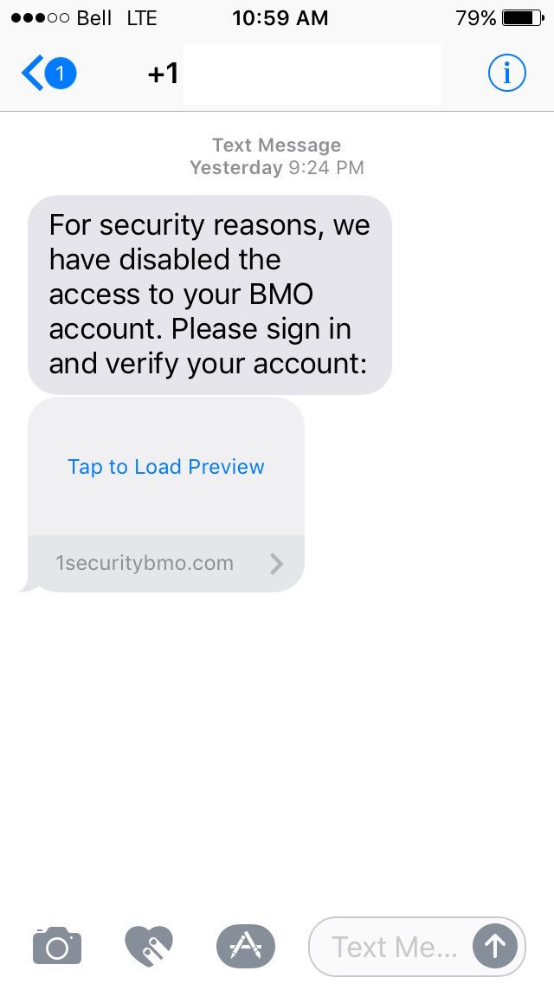
watch out for phishing text messages, too
Notes:
Here is an example of a phishing text message - a text from an unrecognized number, asking you to sign in to “verify” your account, a link to click on and open. This is not a legitimate way of verifying any account.
Instead of clicking the link here - you could go to your account’s website directly.

Slide 35
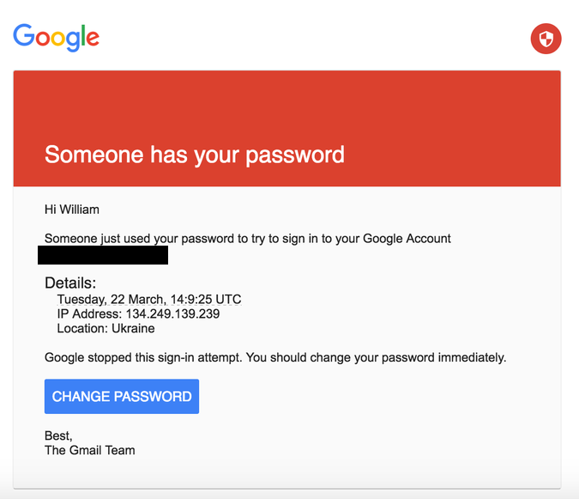
This Email looks urgent …
Notes:
This email looks like I need to change my password right away!
Someone just used my password to sign into my Google Account!
What do I do?
Verify the sender’s address.
Verify the link the “Change Password” button would go to.
This was the exact email that was sent to staff at the DNC - and because someone clicked and entered in their password, hackers were able to gain access to their whole email account.

Slide 36
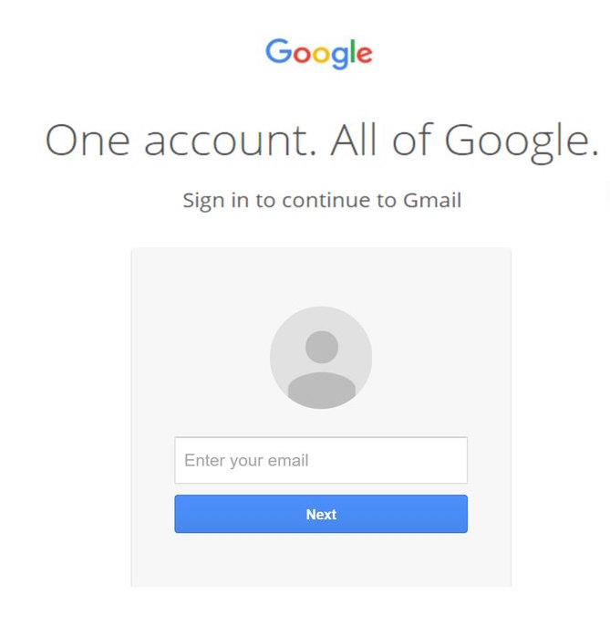
… but be careful
Notes:
And if you clicked through, it would look just like Google’s page. You probably wouldn’t be able to tell. Think of all of the sensitive information in your email: everyone you’ve ever communicated with, thinking your conversations were private. Addresses, phone numbers, all of your contacts, where you are, where you’ve been, what you’ve bought, everything.

Slide 37
recognizing & avoiding fraudulent websites

Slide 38
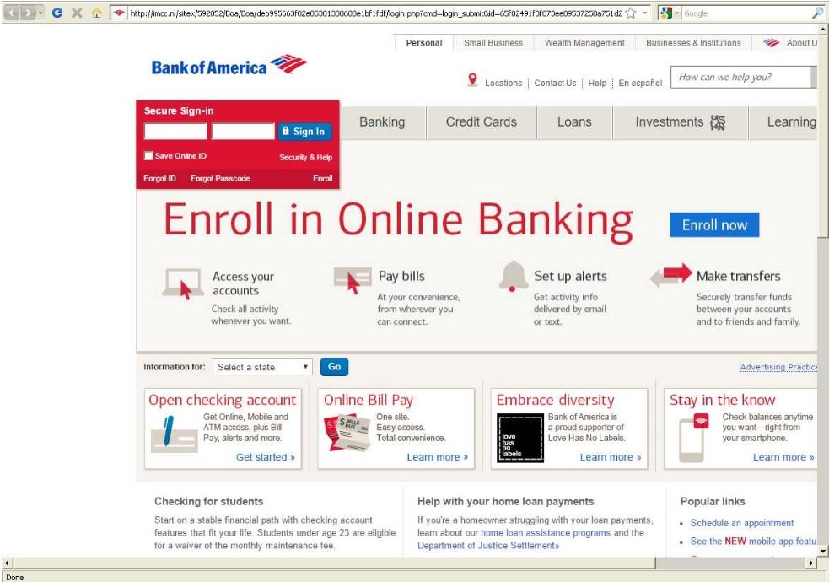
fraudulent sites look very real
Notes:
This is a fraudulent site, but looks just like the Bank of America website.
If I received a fraudulent email, and it got me to click, and I put in my login credentials, I’d be giving away access to my bank account. This is a fraudulent site, and you can tell by the URL.

Slide 39
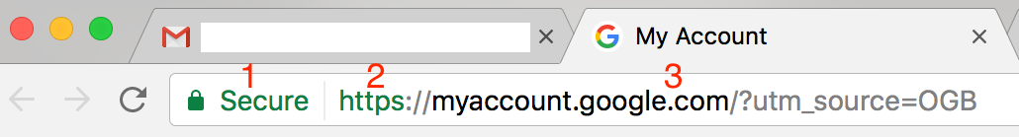
SO how to verify a url?
1) The padlock tells me the connection is secure, not necessarily that the site is legit
2) The S at the end of http also means the connection is secure, not necessarily that the site is legit
Notes:
If there isn’t a padlock, it’s not a secure connection, even if it says https.

Slide 40
https isn’t everywhere
Many legitimate sites are not configured to use https for secure connections, and that’s okay.
But if the connection is NOT secure, then entering your username, password, and any sensitive data is NOT recommended.
Notes:
Without the padlock, it’s possible in theory for a hacker to intercept and read the webpage when communicating between your computer and that website.

Slide 41
SO how to verify a url?
3) Most important is the URL, specifically:
The top-level domain (example: .com)
The second-level domain (what comes immediately before the top-level domain, here: google)
Notes:
There’s a lot of jargon here but it’s important, because this is the most important part of verifying a URL.
What you’re going to look for is the domain, which appears between the https:// (or http://) and the first slash you see after that. In this example, the full domain is myaccount.google.com. Once you know that full domain, you can figure out the top-level and second-level domains by moving from right to left.
(Spend less time on this slide and more time on the examples.)

Slide 42
Fraudulent url examples
https://mygoogleacount.com/securityAlert
https://bankofarnerica.com/sign-in/index.php
https://onlinebanking.wellsfargo.wells-fargo-online-banking.com/myaccount.aspx
https://twitter.com.twitter-followers.link/unfollowers
https://myaccount.google.com/?utm_source=OGB
Notes:
DISCLAIMER: I MADE ALL OF THESE LINKS UP, DON’T VISIT THESE SITES, I DON’T KNOW WHAT IS THERE BUT YOU SHOULD NOT FIND OUT
How do we know each of these is fake? The top-level and second-level domains is not the correct URL in any of these examples.
Google’s URL is google.com, not this, and it’s missing a C anyway
A lowercase R and N next to each other can often easily be mistaken for an M, especially for those with impaired vision and in certain fonts.
Many fake URLs will make the first part of the URL look legit, but that’s NOT the important part
What’s the top-level domain here? What’s the second-level domain?
The fifth example here is actually a legitimate URL, shown here for contrast. What is the top-level domain here? What is the second-level domain?

Slide 43
recognizing & avoiding malicious email attachments

Slide 44
What’s the danger?
Clicking links in fraudulent emails will often lead to websites designed to steal your account credentials and/or infect your computer
Downloading malicious attachments will infect your computer with a virus

Slide 45
email attachments can be dangerous
Be careful with emails you weren’t expecting telling you to open a link or download an attachment
Frequently they will appear to come from friends or colleagues
They’ll commonly have little or no explanation other than “click here” or “download this”
Notes:
We’ve talked a lot about email because email is one of the most common ways you’ll encounter threats - so far we’ve seen phishing emails and scam emails.
I’ve received malicious email attachments from a former colleague whose email account was compromised - they had a virus on their computer and didn’t realize they were sending out emails to people in their address book with copies of that virus in attachments.
I hadn’t spoken to her in over a year, so when I got an email from her telling me I should open up an attachment that had her “vacation pictures” I knew something was wrong.

Slide 46
ask yourself before downloading attachments
Were you expecting the email?
Is it from someone you know?
Can you verify they sent it?
Check the reply-to address. Was it actually from them?
Is it possible their email address is compromised?
Is it from someone you haven’t heard from in a long time?
Notes:
Once an email is compromised, hackers will go through the address book and send to that person’s contacts. They’re relying on you trusting your friend or colleague and opening an attachment from them without thinking about it, without applying the skepticism you should.
Apply the same level of caution when receiving links out of the blue, and verify where the links go before clicking on them!

Slide 47
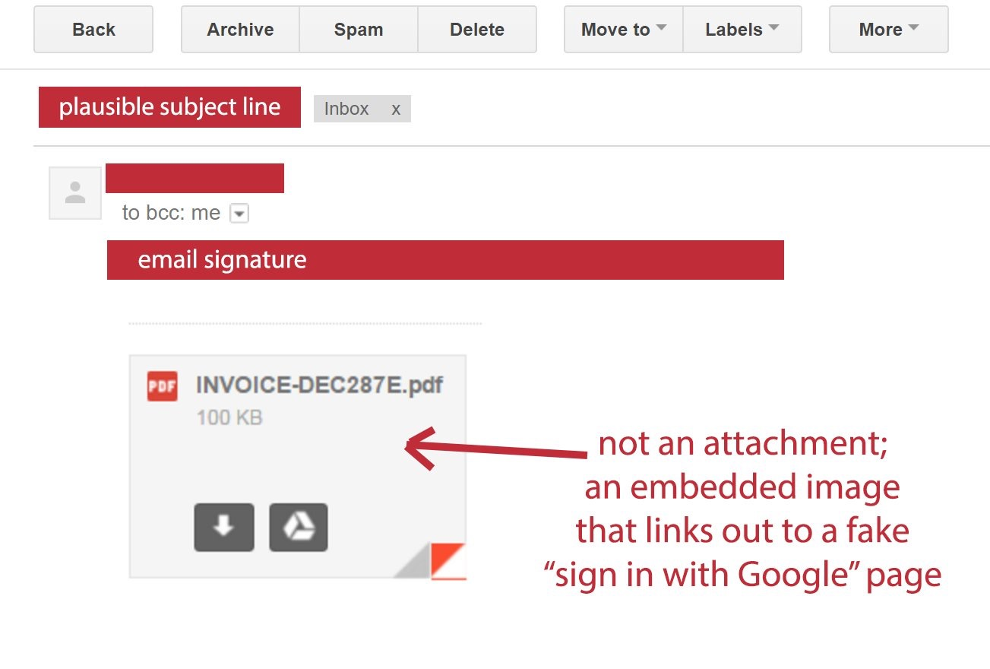
Some attachments are not attachments at all
Notes:
In Gmail, if this were a legitimate attachment, there would be two buttons - Download and Save to Drive - that you could hover over.
In this fraudulent image, those buttons are faked, and hovering over them would do nothing — that is a big red flag, and a sign that you should not click.

Slide 48
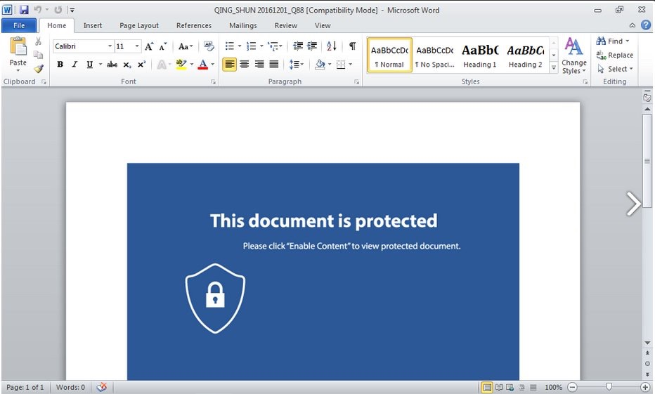
be careful with office documents
Many fraudulent attachments will try to trick you into disabling Office’s built-in protections
Notes:
There’s nothing actually here in this document, but once you follow the instructions, you’ll have a virus on your computer. If you see a document like this, close it and delete it — don’t follow the instructions.

Slide 49
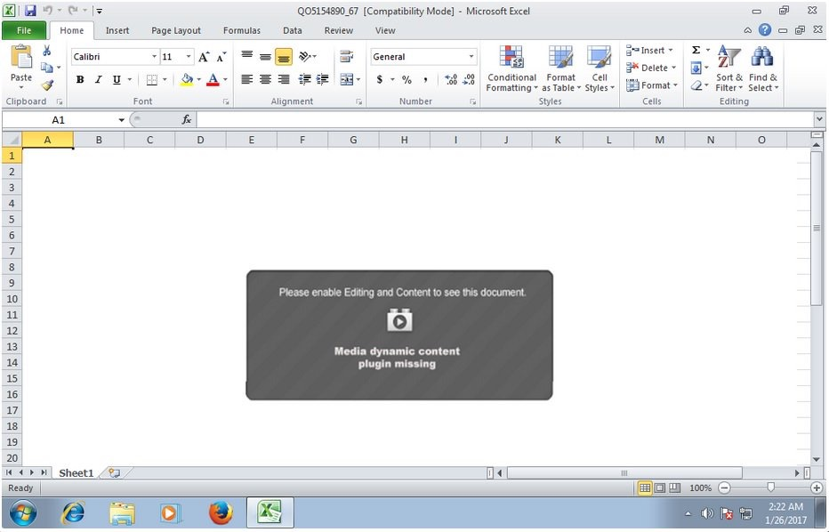
be careful with office documents
Office documents are the most common type of attachment, and they’re safe, right?
Notes:
This is another version of the same malicious attachment.

Slide 50
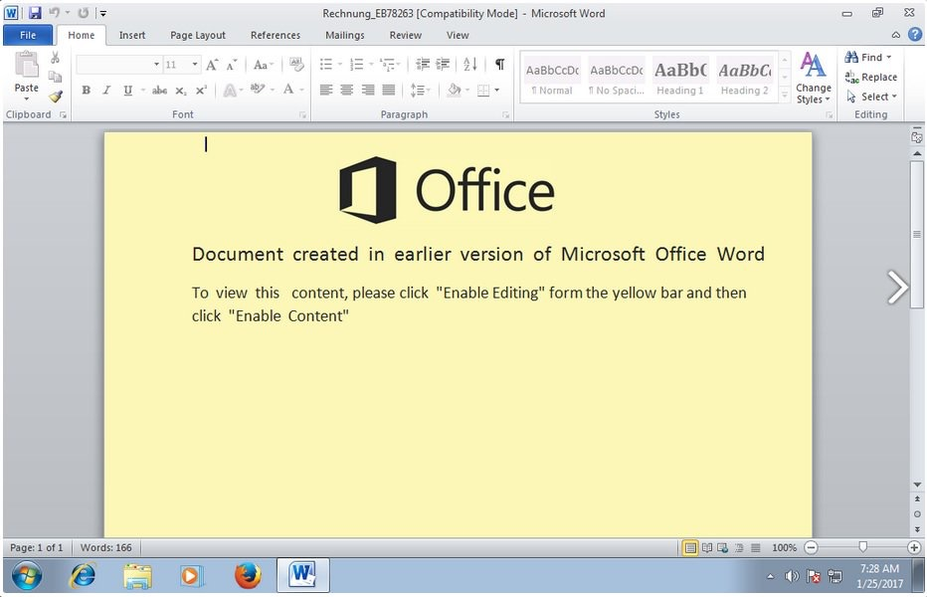
be careful with office documents
There are dozens of versions of this trick
Notes:
Yet another version of the same type of malicious attachment. I have so many screenshots of these.

Slide 51
be careful what you download
Don’t download counterfeit software
Don’t download programs that promise free system scans or PC speed boosts
Especially if they advertise with pop-up windows or flashing advertisements
Download software only from trusted websites

Slide 52
automatic updates
Keep your software up to date
It can be annoying to have to restart your computer to install updates, but don’t put it off
Updates often contain critical security updates
Set up automatic updates to make it easier on yourself

Slide 53
password protecting your computer

Slide 54
Set a lock screen with password
Make sure you need to enter a password to access your computer:
On startup
On waking up from sleep
On exiting the screensaver
Set up a password-protected screensaver to start after a few minutes of inactivity
Notes:
How many minutes of inactivity for your screensaver will depend on how you use your computer and what you’re trying to protect from, but keep in mind if anyone can physically access your computer without a password, they can in theory read all your emails, reset accounts, and so on.

Slide 55
walking away? lock it up!
Get in the habit of locking your computer every time you walk away from it.
On Windows, the keyboard shortcut to lock your computer is Windows + L
On a Mac, you can set up your Hot Corners to lock your screen
Don’t forget to use a strong password!
Notes:
I have my Hot Corners set so when I move my mouse to the lower-right hand side of my screen, it will automatically lock my computer, which is very convenient.
To set your Hot Corners and Screen Saver, go to the Apple Menu > System Preferences, and in the top row, go to Desktop & Screen Saver > Screen Saver.

Slide 56
Be sure to lock your phone, too
iPhone users, make sure your password is at least 6 digits long
Android users, use a long, complicated pattern to unlock
Police can force you to unlock your phone with your fingerprint, but can’t ask for your password
Remember what makes for a good (or bad) password!
Notes:
You’ll also want to configure your phone to lock itself after a certain period of inactivity. How long will depend on how you use your phone.
You might want to consider activating the feature that will erase all data on the phone after several failed password attempts to prevent someone from trying every password in the book.

Slide 57
prevent 99% of attacks
Learn to recognize fraudulent emails and websites
Don’t open, don’t click, don’t download attachments, don’t enter your information
They’re trying to trick you. Be skeptical.
Keep your software up to date
Use strong passwords and a password manager
Use two-factor authentication where available
Notes:
This is maybe the most important slide, and is a good summary of everything we’ve covered.

Slide 58
continue learning
Resources and additional trainings will be added here periodically.

